Slide 1
MY BIOGRAPHY
Santiago Arias Mosquera
2250070

Slide 2
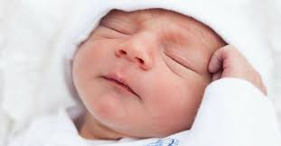
I was born on January 20th in 2004

Slide 3
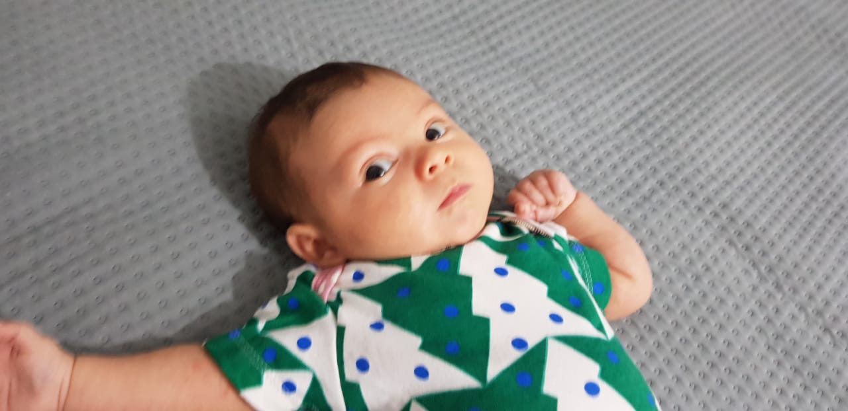
When i was two years old my youngest brother was born

Slide 4
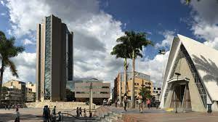
My birthplace and hometown is Armenia

Slide 5
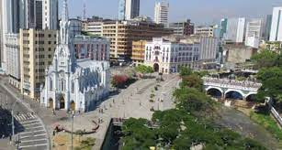
But i was 16 years old, we moved to Cali

Slide 6
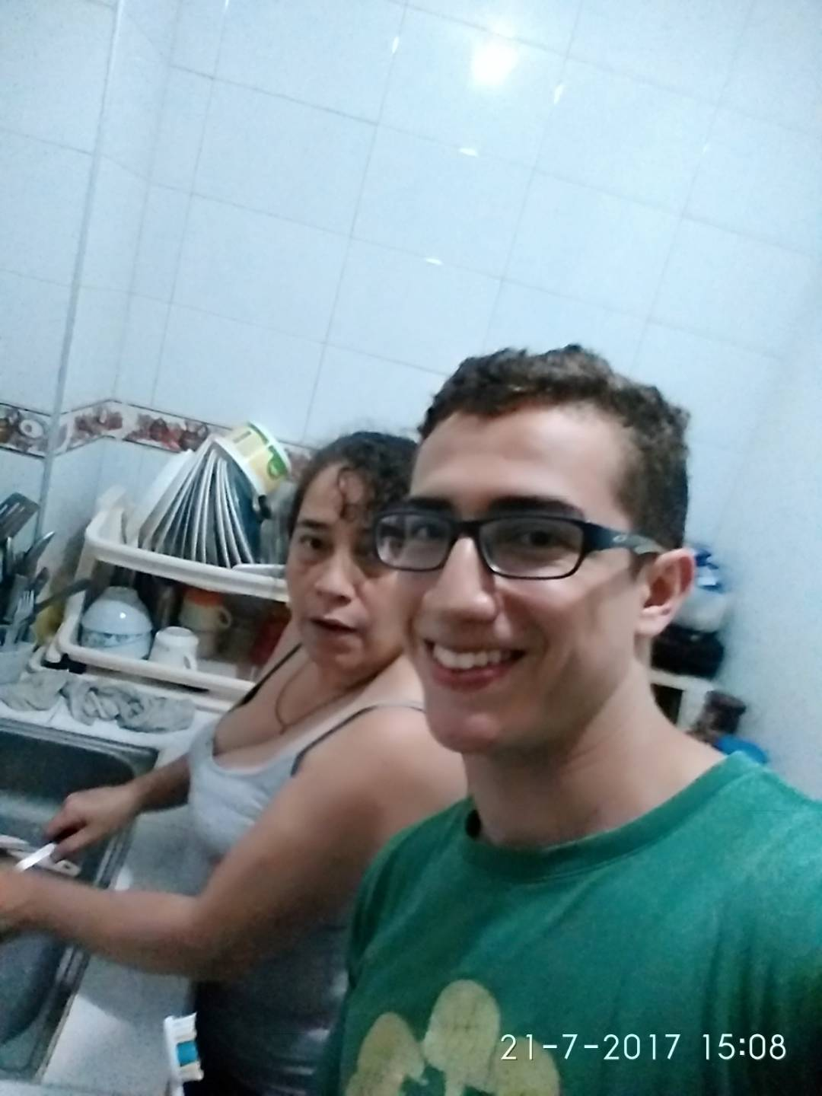
My mom said that didn’t like live in Cali , but odldest brother thought differently

Slide 7
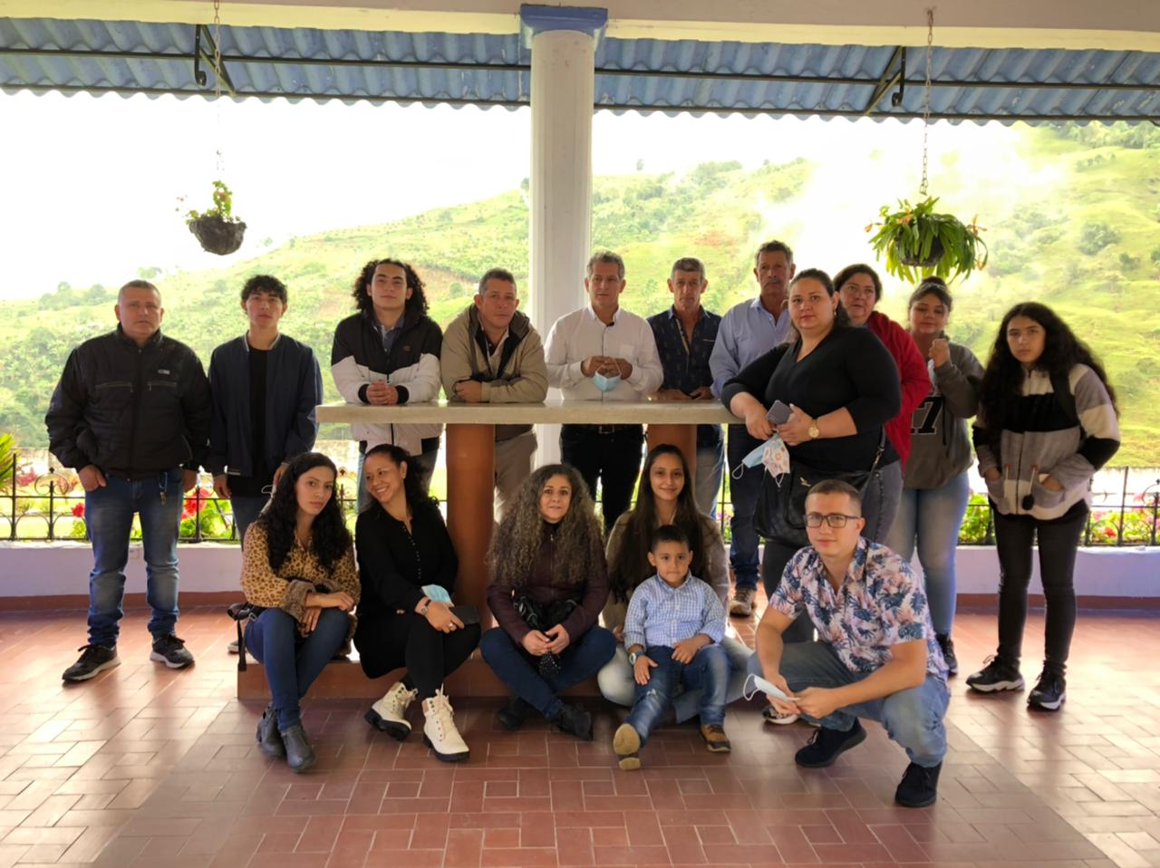
We returned to Armenia for our family

Slide 8
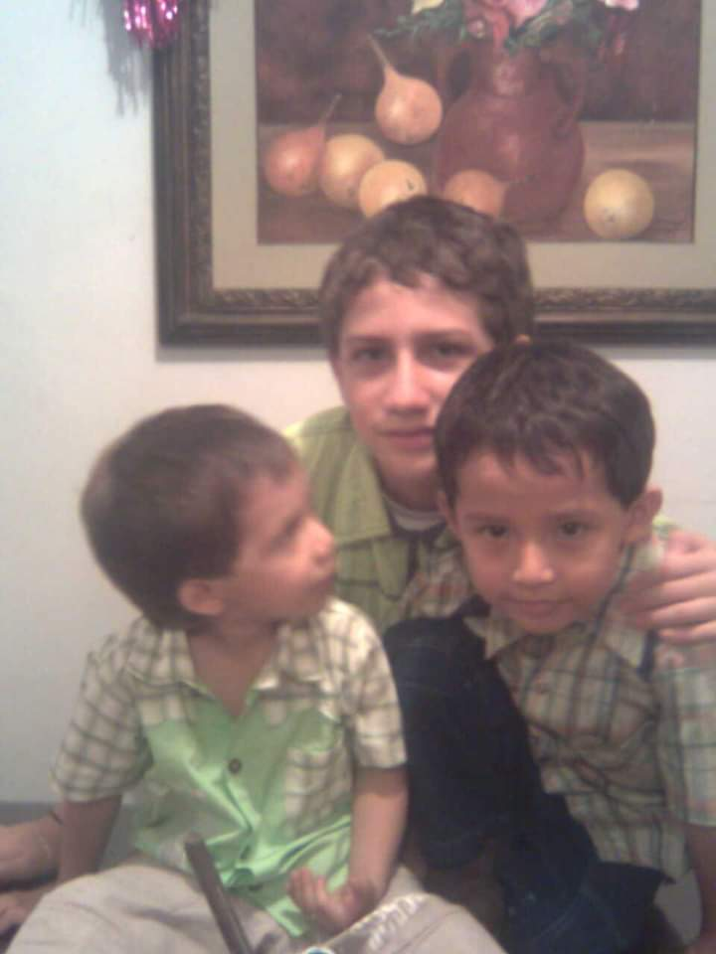
We were happy

Slide 9
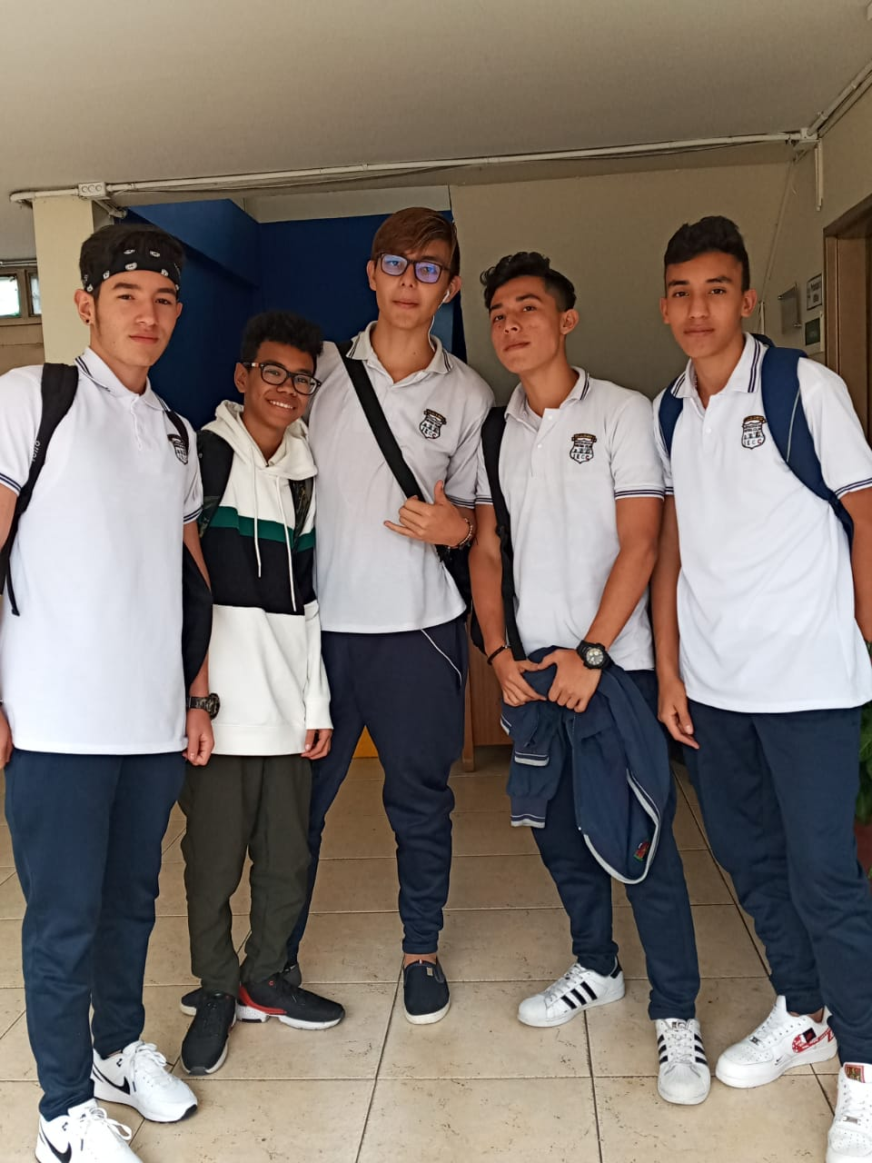
I graduated in IECC school with my Friends

Slide 10
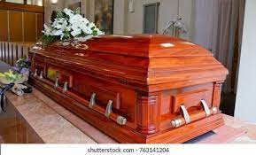
When my grandfather died everybody cried

Slide 11
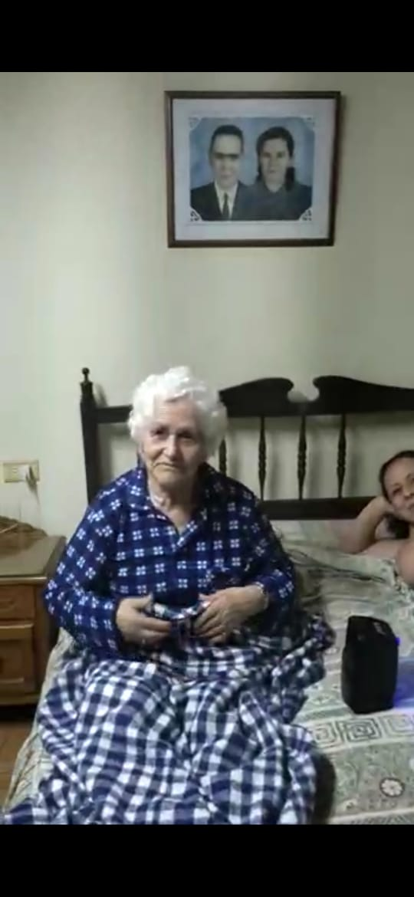
after my grandmother lost memory

Slide 12
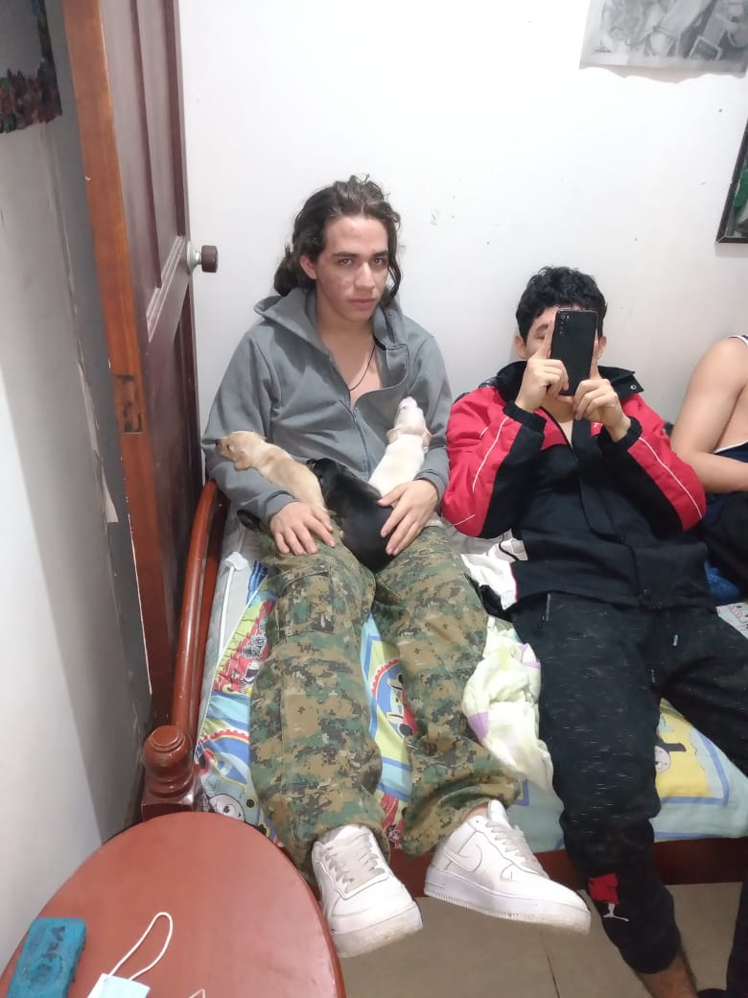
We went to home and i returned my life with my family and friends

Slide 13
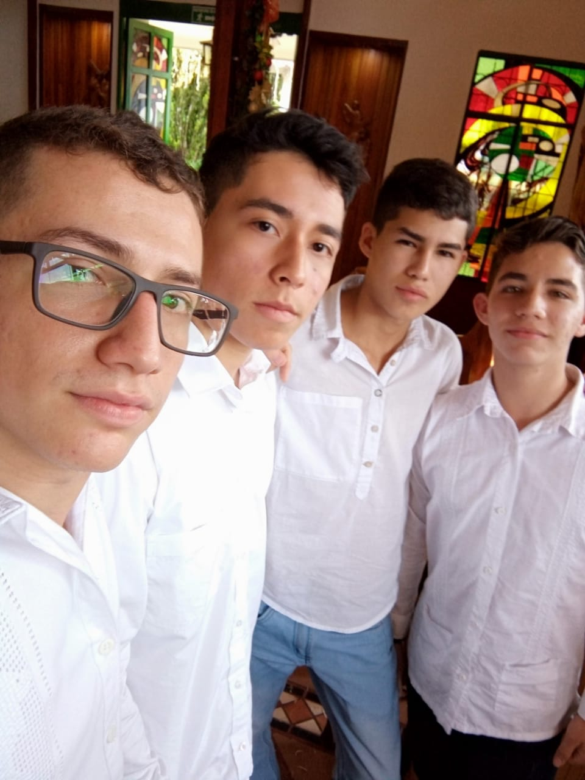
My cousin got married

Slide 14

And me started study at SENA

